Slide 1
Chapter 8: Validity (Part 1)

Slide 2
Introduction
Scenario: Using a personality inventory to screen job candidates
Rejected ☹
  What questions would you ask about the measure?
  What does the personality test actually measure?
  Is there any actual evidence that the test is good at measuring personality?
  Any theoretical reason for why scores on this test are related to job performance?
  What about actual data showing a link between test performance and job performance?
Notes:
Questions asked by a rejected candidate about personality inventory:
What was the personality inventory supposed to measure exactly?
Whether there was evidence that the inventory is a good measure of whatever it is supposed to be measured?
Whether there is any logical or theoretical reason to believe that scores on the inventory are related to performance in the job that you wanted?
Important one is are there any hard data showing that scores on the inventory are actually related to performance in your job?
Response of HR director to the questions:
They might state that the personality inventory is a worthwhile part of the hiring process.
They might also assure that the company has been using it for years and that in their experience, the questionnaire is quite accurate and useful for predicting who will be good employees.
Need for stronger evidence: If the inventory is used to make important decisions, then HR director needs to have stronger evidence than “their experience” testifying to the accuracy and utility of the questionnaire.

Slide 3
What Is Validity? (1 of 6)
All of these questions are getting at the measure's validity
Validity = Degree to which test measures what it is supposed to
In psychometrics, validity specifically deals with interpretation and use of a measure’s scores
  NOT whether or not the actual measure is valid!!!
Notes:
Validity: The degree to which a test measures what is it supposed to measure.
Interpretations and uses of a measure’s scores: Validity is about the interpretation and uses of a measure’s scores in terms of a specific psychological construct; it is not about the measure itself which is neither valid nor invalid.
Conscientiousness scale on Revised NEO-Personality Inventory (NEO-PI-R):
NEO-PI-R is a multidimensional personality inventory, providing scores on five relatively independent domains, each of which includes six, narrower “facet” dimensions.
One of the factors included in the NEO-PI-R is labeled Conscientiousness which includes 48 items, with each item presenting a statement regarding beliefs, interests, behaviors, and so on.
The authors of the NEO-PI-R state that high scores on this set of items reflect the tendency toward an “active process of planning, organizing, and carrying out tasks,” and they state that people with high scores are “purposeful, strong willed, and determined.”
The NEO-PI-R conscientiousness scale might be used by employers to screen applicants.
Experts in HR predict that people who have relatively high scores of conscientiousness scale will be responsible, hardworking, motivated, and dependable employees.
Usefulness of psychological measures:
Psychological measures are tools and a given measure is useful for some jobs but not others.
It is simplistic and inaccurate to say that a particular psychological measure, such as the NEO-PI-R conscientiousness scale, is valid, without regard to the way in which it will be interpreted and used.
The scale’s scores might be interpreted validly as indicators of conscientiousness and might help select a conscientious contractor, but the scores are not validly interpreted as indicators of intelligence or extroversion.

Slide 4
What Is Validity? (2 of 6)
Example: NEO Personality Inventory (Big-5)
  Conscientiousness scale (48 items)
  What do high scores mean?
  HR experts might predict that high C individuals will be responsible, hardworking, motivated, etc.
  Valid to use these scores as indicators of other factors that might influence job performance?
Notes:
Validity: The degree to which a test measures what is it supposed to measure.
Interpretations and uses of a measure’s scores: Validity is about the interpretation and uses of a measure’s scores in terms of a specific psychological construct; it is not about the measure itself which is neither valid nor invalid.
Conscientiousness scale on Revised NEO-Personality Inventory (NEO-PI-R):
NEO-PI-R is a multidimensional personality inventory, providing scores on five relatively independent domains, each of which includes six, narrower “facet” dimensions.
One of the factors included in the NEO-PI-R is labeled Conscientiousness which includes 48 items, with each item presenting a statement regarding beliefs, interests, behaviors, and so on.
The authors of the NEO-PI-R state that high scores on this set of items reflect the tendency toward an “active process of planning, organizing, and carrying out tasks,” and they state that people with high scores are “purposeful, strong willed, and determined.”
The NEO-PI-R conscientiousness scale might be used by employers to screen applicants.
Experts in HR predict that people who have relatively high scores of conscientiousness scale will be responsible, hardworking, motivated, and dependable employees.
Usefulness of psychological measures:
Psychological measures are tools and a given measure is useful for some jobs but not others.
It is simplistic and inaccurate to say that a particular psychological measure, such as the NEO-PI-R conscientiousness scale, is valid, without regard to the way in which it will be interpreted and used.
The scale’s scores might be interpreted validly as indicators of conscientiousness and might help select a conscientious contractor, but the scores are not validly interpreted as indicators of intelligence or extroversion.

Slide 5
What Is Validity? (3 of 6)
Validity is a matter of degree!
  Weak vs. Strong NOT all vs. none!
How to pick a measure based on validity?
  Anecdotal evidence?
  Empirical evidence?
Notes:
Using the phrase validity of a test:
The test user might not have a sophisticated understanding of validity.
It is simply a shortcut.
Validity is a matter of degree and not an “all-or-none” issue:
This implies that the validity of a test interpretation should be conceived in terms of strong versus weak instead of simply valid or invalid.
For test users, validity should be a deciding factor in their choice of psychological tests.
Even though such choices are based on a number of practical, theoretical, and psychometric factors, a test should be selected only if there is strong enough evidence supporting the intended interpretation and use.
Alternatively, the test users might need to choose from a set of possible tests, and they must weigh the relative strengths of the tests being taken into consideration.
Validity of a test’s interpretation is based on evidence and theory:
For a test user to be confident in an interpretation and use of test scores, anecdotal evidence is insufficient.
Instead, there must be good empirical evidence supporting the interpretation and use.
Example: The analysis of hand writing is a popular method for “assessing” personality but there appears to be little peer-reviewed scientific evidence that handwriting actually reveals anything about personality.
Color Quiz:
Also known as “Colorgenics,” or the “Personality Color Test.”
These tests are based on “color psychology,” as developed by Max Lüscher.
While taking the test, we are presented with eight colors and are asked to select the colors in the order of our preferences.
After completing this procedure twice, we receive a series of interpretations regarding our “sources of stress,” “restrained characteristics,” “desired objectives,” and “actual problems.”
This is an interesting idea, but there is no support for the validity of color preferences as a measure of personality characteristics.

Slide 6
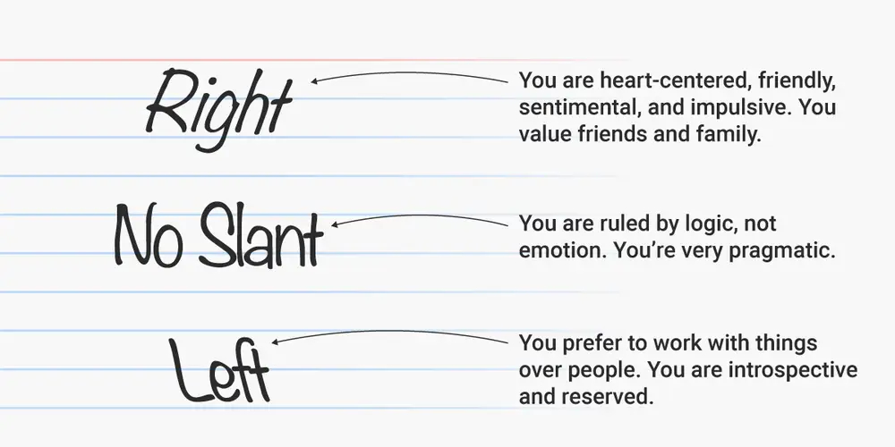
What Is Validity? (4 of 6)
Example: Handwriting and Personality
https://www.rd.com/list/handwriting-analysis/
Notes:
Using the phrase validity of a test:
The test user might not have a sophisticated understanding of validity.
It is simply a shortcut.
Validity is a matter of degree and not an “all-or-none” issue:
This implies that the validity of a test interpretation should be conceived in terms of strong versus weak instead of simply valid or invalid.
For test users, validity should be a deciding factor in their choice of psychological tests.
Even though such choices are based on a number of practical, theoretical, and psychometric factors, a test should be selected only if there is strong enough evidence supporting the intended interpretation and use.
Alternatively, the test users might need to choose from a set of possible tests, and they must weigh the relative strengths of the tests being taken into consideration.
Validity of a test’s interpretation is based on evidence and theory:
For a test user to be confident in an interpretation and use of test scores, anecdotal evidence is insufficient.
Instead, there must be good empirical evidence supporting the interpretation and use.
Example: The analysis of hand writing is a popular method for “assessing” personality but there appears to be little peer-reviewed scientific evidence that handwriting actually reveals anything about personality.
Color Quiz:
Also known as “Colorgenics,” or the “Personality Color Test.”
These tests are based on “color psychology,” as developed by Max Lüscher.
While taking the test, we are presented with eight colors and are asked to select the colors in the order of our preferences.
After completing this procedure twice, we receive a series of interpretations regarding our “sources of stress,” “restrained characteristics,” “desired objectives,” and “actual problems.”
This is an interesting idea, but there is no support for the validity of color preferences as a measure of personality characteristics.

Slide 7
What Is Validity? (5 of 6)
Example: Handwriting and Personality
https://www.rd.com/list/handwriting-analysis/
But is there any actual evidence that this is a thing?
  Dazzi & Pedrabissi (2008) Nope!
  Gavirlescue & Vizireanu (2018) Maybe but its complicated?
Compared to Big-5, handwriting is a less valid approach to assessing personality
Notes:
Using the phrase validity of a test:
The test user might not have a sophisticated understanding of validity.
It is simply a shortcut.
Validity is a matter of degree and not an “all-or-none” issue:
This implies that the validity of a test interpretation should be conceived in terms of strong versus weak instead of simply valid or invalid.
For test users, validity should be a deciding factor in their choice of psychological tests.
Even though such choices are based on a number of practical, theoretical, and psychometric factors, a test should be selected only if there is strong enough evidence supporting the intended interpretation and use.
Alternatively, the test users might need to choose from a set of possible tests, and they must weigh the relative strengths of the tests being taken into consideration.
Validity of a test’s interpretation is based on evidence and theory:
For a test user to be confident in an interpretation and use of test scores, anecdotal evidence is insufficient.
Instead, there must be good empirical evidence supporting the interpretation and use.
Example: The analysis of hand writing is a popular method for “assessing” personality but there appears to be little peer-reviewed scientific evidence that handwriting actually reveals anything about personality.
Color Quiz:
Also known as “Colorgenics,” or the “Personality Color Test.”
These tests are based on “color psychology,” as developed by Max Lüscher.
While taking the test, we are presented with eight colors and are asked to select the colors in the order of our preferences.
After completing this procedure twice, we receive a series of interpretations regarding our “sources of stress,” “restrained characteristics,” “desired objectives,” and “actual problems.”
This is an interesting idea, but there is no support for the validity of color preferences as a measure of personality characteristics.

Slide 8
What Is Validity? (6 of 6)
Validity requires both theory and evidence for a particular interpretation of test scores
Three types of validity:
  Content, criterion, and construct validity.
  Main focus is on construct validity!
Notes:
Theory and empirical evidence supporting interpretation of test scores:
The contemporary perspective on validity states that there must be psychological theory and empirical evidence supporting a particular interpretation of test scores.
Examples:
Is there evidence to show that students who perform well on the SAT actually obtain higher grades in college than do students who perform less well on the SAT?
Is there strong data demonstrating that people who score relatively highly on the NEO-PI-R conscientiousness scale are actually higher in “conscientiousness” than those who score low relatively?
Is there any proof to support the notion that color preferences actually reflect anything about an individual’s personality?
Three types of validity:
Content validity, criterion validity, and construct validity.
Construct validity:
The degree to which test scores can be interpreted as reflecting a particular psychological construct.
Depends on the content of the test, the internal structure of the test, the psychological process used in test responses, the association among test scores and other variables, and the consequences of test use.

Slide 9
Construct Validity
Construct validity: degree of interpretation of test scores.
Answers the question: How well do test scores reflect a particular construct?
Factors affecting it: Content and structure of test, psychological processes of the response, relationship between test score and other variables, consequences of test use, etc.
Notes:
Theory and empirical evidence supporting interpretation of test scores:
The contemporary perspective on validity states that there must be psychological theory and empirical evidence supporting a particular interpretation of test scores.
Examples:
Is there evidence to show that students who perform well on the SAT actually obtain higher grades in college than do students who perform less well on the SAT?
Is there strong data demonstrating that people who score relatively highly on the NEO-PI-R conscientiousness scale are actually higher in “conscientiousness” than those who score low relatively?
Is there any proof to support the notion that color preferences actually reflect anything about an individual’s personality?
Three types of validity:
Content validity, criterion validity, and construct validity.
Construct validity:
The degree to which test scores can be interpreted as reflecting a particular psychological construct.
Depends on the content of the test, the internal structure of the test, the psychological process used in test responses, the association among test scores and other variables, and the consequences of test use.

Slide 10
The Importance of Validity (1 of 3)
Without validity, measurements are scientifically meaningless (and maybe even hazardous?)
Links back to goal of science!
Notes:
Validity as a crucial factor in psychological research:
When psychological measurements are conducted for a serious purpose, they must have sufficient validity for their intended purpose.
Without validity those measurements are scientifically meaningless and potentially even hazardous.
Our ability to interpret behavioral research hinges on test validity.
Goals of scientific research:
To describe, predict, and explain some aspect of the world whether it is a physical or a psychological aspect.
Accurate description, prediction, and explanation depend heavily on the ability to manipulate or measure specific variables that are deemed important.
To guide decision-making about various aspects of our social world.
These decisions can be made at the societal level or individual level.
Test validity has important implications for both kinds of decisions.
Examining the impact of violent video games:
Some psychologists have examined the hypothesis that exposure to violent video games increases one’s inclination to behave aggressively.
Some research seems to indicate that exposure to video violence does affect aggressive behavior.
However, the meaningfulness of this research partially hinges on the measurement of “inclination to behave aggressively.”
If this key variable is measured with good validity, then we should have increased confidence in the conclusion that aggression is increased by exposure to video violence.
However, if the “inclination to behave aggressively” is measured with poor validity, then we should have serious doubts about this net result or conclusion.
Without test validity, our ability to understand of the role of video games in aggressiveness is limited.
Test validity:
Validity influences the scientific process in a somewhat abstract sense, in that it affects the accuracy of our understanding of the world.
Test validity can have an even more concrete impact on the outcome of the scientific process.
Without test validity, decisions about societal issues could be misinformed, wasteful, or even harmful.

Slide 11
The Importance of Validity (2 of 3)
Example: Impact of violent video games.
To investigate this question:
  How is aggressive behavior measured?
  If measured poorly, serious doubts about any link between violent media and aggression!
  Without test validity, wrong interpretations could be made
Notes:
Validity as a crucial factor in psychological research:
When psychological measurements are conducted for a serious purpose, they must have sufficient validity for their intended purpose.
Without validity those measurements are scientifically meaningless and potentially even hazardous.
Our ability to interpret behavioral research hinges on test validity.
Goals of scientific research:
To describe, predict, and explain some aspect of the world whether it is a physical or a psychological aspect.
Accurate description, prediction, and explanation depend heavily on the ability to manipulate or measure specific variables that are deemed important.
To guide decision-making about various aspects of our social world.
These decisions can be made at the societal level or individual level.
Test validity has important implications for both kinds of decisions.
Examining the impact of violent video games:
Some psychologists have examined the hypothesis that exposure to violent video games increases one’s inclination to behave aggressively.
Some research seems to indicate that exposure to video violence does affect aggressive behavior.
However, the meaningfulness of this research partially hinges on the measurement of “inclination to behave aggressively.”
If this key variable is measured with good validity, then we should have increased confidence in the conclusion that aggression is increased by exposure to video violence.
However, if the “inclination to behave aggressively” is measured with poor validity, then we should have serious doubts about this net result or conclusion.
Without test validity, our ability to understand of the role of video games in aggressiveness is limited.
Test validity:
Validity influences the scientific process in a somewhat abstract sense, in that it affects the accuracy of our understanding of the world.
Test validity can have an even more concrete impact on the outcome of the scientific process.
Without test validity, decisions about societal issues could be misinformed, wasteful, or even harmful.

Slide 12
The Importance of Validity (3 of 3)
Violent video games: 2006 Hearings in the US House of Representatives.
  Hearings assumed that violent games == violent behavior
  Is there strong evidence? If yes, assumption is warranted. If no, then this is potentially a waste of resources
  Potential consequences?
Notes:
Hearings held in the US House of Representatives:
In 2006, the US House of Representatives held hearings concerning the level of violence depicted in many popular video games and its effect particularly on younger players.
The hearings were based on the assumption that exposure to violent video games increases aggressive behavior.
If there is strong research to support the assumption, then the hearing is warranted; however, if it is based on poor validity, then we should have serious doubts about the meaning of that research.
If the US Congress enacted legislation on the basis of research with questionable validity, congressional time, and attention would be wasted, and misguided laws could be passed.
Valuable funds could also be wasted that could be used for alternative program for the betterment of society.
Test validity and test-based decisions:
Without test validity, test-based decisions about individuals could be misinformed or harmful.
Decisions that are based on psychological testing have potentially life-altering implications for the individuals affected by them, and test validity dramatically impacts those decisions.
Decisions based on well-validated measures benefit the test users and test takers.
Decisions based on poorly validated tests can be based on the inappropriate use of tests that have been well validated for different uses.

Slide 13
Facets of Validity
Five facets of validity:
  Content
  Internal Structure
  Response
  Associations
  Consequences
Notes:
Five facets of validity:
Content.
Internal structure.
Response process.
Associations.
Consequences.
Content validity:
The match between the actual content of a test and the content that should be included in the test.
If a test is to be interpreted as a measure of a particular construct, then the content of the test should reflect the important facets of that construct alone.
Typical relevant evidence for content validity: Typical evidence includes expert ratings of test content.

Slide 14
Content Validity (1 of 2)
Content validity: match between actual content and expected content.
How is this determined?
Expert Rating Evidence
  Obtaining evidence of content validity.
  Example: The ACT
Notes:
Five facets of validity:
Content.
Internal structure.
Response process.
Associations.
Consequences.
Content validity:
The match between the actual content of a test and the content that should be included in the test.
If a test is to be interpreted as a measure of a particular construct, then the content of the test should reflect the important facets of that construct alone.
Typical relevant evidence for content validity: Typical evidence includes expert ratings of test content.

Slide 15
Content Validity (2 of 2)
Threats to Content Validity (Violations)
  Construct-irrelevant content
  Construct underrepresentation
Trade-off between content validity and reality.
  Whatever construct you are interested in should be adequately assessed!
  But impossible to include everything
  Focus on a reasonable range of detail
Notes:
Two principles of content validity:
A test should include no content that is irrelevant to the construct for which the test is to be interpreted.
A test should include content that is relevant to the full range of the construct, as much as possible.
Two threats of content validity:
Construct-irrelevant content: Test content that reflects issues, characteristics, or concepts that are irrelevant to the construct for which a test is to be interpreted.
Construct underrepresentation: Occurs when a test has weak validity, which means that its actual content fails to represent the full scope of the content implied by the construct that it is intended to measure.
The test’s content should reflect the full range of the core construct, nothing more and nothing less.
Trade-off between content validity and the reality:
A test should include items that represent an adequate sample of the construct-relevant content; however, there is no clear rule for such representation.
A test developer might not be able to include content covering every small detail of the construct to an equally thorough degree.
So, the test might not cover every conceivable facet or subfacet of the construct, but the test items reflect a reasonable range of elements relevant to the full range of the construct.

Slide 16
Content Validity vs. Face Validity
Face validity: Degree to which measure reflects specific construct.
  Not considered an important psychometric property
But… does the content look relevant to the person taking the test?
  If yes: Reactivity
    Example?
  If no: Could compromise degree to which participants take test seriously
    Example?
Content validity: Degree to which measure reflects full domain of construct.
Notes:
Face validity:
The degree to which a measure appears to be related to a specific construct, in the judgment of nonexperts, such as test takers.
Applicable only if the content of a test looks relevant to the person taking the test.
Not considered an important psychometric issue.
Implications of face validity for test’s use:
It might influence test takers’ motivation to respond in a serious and honest manner.
Example:
Consider a psychological inventory given to job applicants as part of the hiring process for a law enforcement agency.
Applicants assume that such a measure should include questions about problem solving, social skill, dependability, work ethics, and so on.
If the inventory included questions about sexual attitudes or family history, then the job applicants might question the legitimacy or relevance of the entire testing procedure.
Consequently, they might respond randomly, in a way that presents a falsely positive image of themselves, or even refuse to complete the measure altogether.
The utility of such a test would be almost entirely compromised.
Hence, a test with high face validity might be much better received by test takers and potential test users.
Content validity:
The degree to which the content of a measure truly reflects the full domain of the construct for which it is being used.
Can be evaluated only by those who have a deep understanding of the construct in question.
Considered important form of evidence in the overall evaluation of construct validity.

Slide 17
Internal Structure of the Test
Key Issue: How are different parts of test related?
A test is only valid if measured structure matches theorized structure
Examples:
  Rosenberg Self-Esteem Inventory
    Measures Global self-esteem
    If valid, should assess only one construct
  Multidimensional Self-Esteem Inventory (MSEI)
    Measures Global + Eight components
    If valid, items for each subscale should be more closely related
Notes:
Internal structure of test:
The way in which the parts of the test are related to each other.
Example: Some tests include items that are highly correlated with each other, while others include items that fall into two or more clusters.
Match between actual and expected internal structure of test:
This is an important validity issue.
A test can be validly interpreted as a measure of a particular construct only if the actual structure of the test matches the theoretically based structure of the construct.
Rosenberg self-esteem inventory (RSEI):
It is the most commonly used measure of self-esteem in psychological research.
It is often used as a measure of a single coherent construct, global self-esteem.
Global self-esteem is one’s overall evaluation of one’s self-worth, and the RSEI includes 10 items.
Users intending to interpret scores on the RSEI as a measure of global self-esteem should expect to find a particular structure among the 10 items.
If the RSEI is valid as a measure of global self-esteem, then the responses to the test items should exhibit a unidimensional structure which is consistent with a conceptual definition of the construct.
Multidimensional self-esteem inventory (MSEI):
It was designed to measure global self-esteem along with eight components of self-esteem.
The test authors state that the conceptual model underlying the MSEI specifies two primary levels within the hierarchy of self-esteem.
The first level corresponds to global self-esteem which is concerned with the person’s most basic, widely generalized evaluative feelings about him/herself.
The second level corresponds to self-evaluations at an intermediate level of generality, which are referred to as components of self-esteem.
If the scores of MSEI are validly interpreted as measures of these components of self-esteem, then responses to the test items should exhibit a structure that is consistent with the multidimensional conceptual definition of the construct.

Slide 18
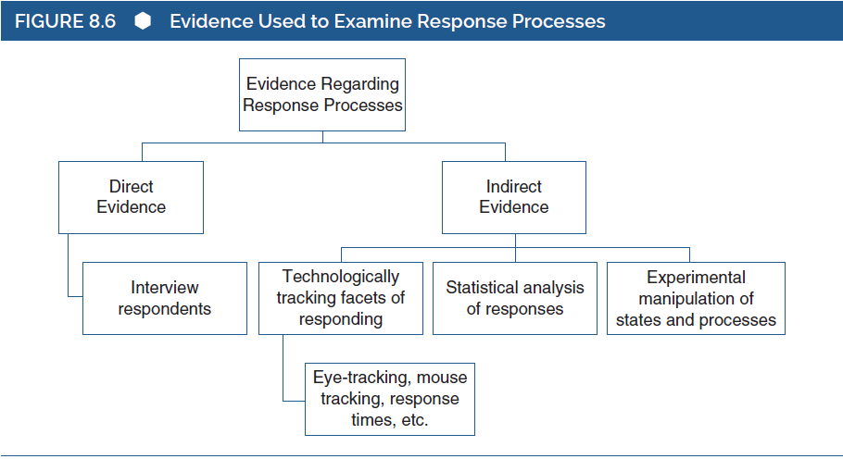
Response Processes
Key Issue: Match between processes actually used at test and processes that should be used
Notes:
Response process: The match between the psychological processes that respondents actually use when completing a measure and the processes that they should use.
The effect of control deprivation on cognitive performance:
In this study, all participants were given a noise control task in which they were exposed to a loud buzzing noise, and were instructed to learn a sequence of keystrokes that would temporarily suppress the noise.
During the task, half the participants were required to learn a very easy sequence, which ensured that they would eventually control the noise.
The other half were required to learn an impossible sequence, which ensured that they would lack control over the noise.
After this task, all participants completed a series of word tasks where they were given a list of scrambled words (e.g., pynhm) and were required to identify the correct word (e.g., nymph).
The total number of words correctly unscrambled was taken as the measure of cognitive performance.
The researchers hypothesized that control deprivation on the noise task would impair attention, which would produce lower scores on the word scramble task and those with good control could produce higher scores.
Results and suggestions of the study:
The participants who had experienced control deprivation on the noise task completed just as many words as did the participants who had not experienced control deprivation.
Many researchers would have taken this as evidence against the hypothesized effect of control deprivation on cognitive performance.
However, closer inspection revealed that more participants in the control deprivation group “cheated” as compared with the control group.
This suggests that it is possible that the hypothesis was actually correct, which reduces cognitive performance, but the participants who had experienced control deprivation also cheated, which inflated their scores on the measure of cognitive performance.
This study illustrates that the construct validity can be evaluated in part by considering the processes involved in responding to a measure.
Böckenholt’s framework of psychological process:
In this framework, a person goes through three steps when responding to this type of item.
First, she decides whether she has a clear opinion or standing on the item.
If she has no clear idea, she would choose the neutral (neither agree nor disagree) response option.
If she does have a clear idea, then she would move to the next step.
Then, she would decide whether she generally agrees or disagrees with the statement.
Then, the person decides how intensely she agrees or disagrees with the statement.
This framework has been used by researchers in the psychometric examination of psychological measures.

Slide 19
Associations with Other Variables (1 of 3)
Key Issue: If test scores reflect a participant’s level(s) of a construct, then test scores should be associated w/ test scores for variables that are thought to be related
Example: Self-Esteem and Depression
  Theory: Individuals w/ low self-esteem are more likely to be depressed
  High associative validity == pattern of association consistent with this theory
  Specific Pattern?
Notes:
The contemporary view of validity:
It emphasizes the theoretical understanding of the construct for which test scores are to be interpreted.
Based on this view, we should consider the way in which that construct is connected to other relevant psychological constructs.
If respondents’ test scores are to be interpreted as reflecting the respondents’ standing on a specific psychological construct, then the nature of that constructs should lead us to expect that test scores will have particular patterns of associations with other variables.
Interpretation of RSEI as a measure of global self-esteem:
To this, we need to consider the way in which global self-esteem is associated with other psychological constructs such as happiness, depression, intelligence, social motivation, assertiveness, and so on.
Our theoretical perspective on self-esteem might lead us to believe that people with high levels of self-esteem should be relatively happy, relatively nondepressed, and relatively highly socially motivated.
In addition, our theoretical perspective might state that self-esteem is unrelated to intelligence: people with low levels of self-esteem are equally intelligent, on average, as people with high levels of self-esteem.
Thus, our theoretical perspective on self-esteem suggests a particular pattern of associations between self-esteem and other psychological constructs.
If RSEI scores are to be validly interpreted as a measure of self-esteem, then we should find a particular pattern of associations between RSEI scores and measures of happiness, depression, social motivation, and intelligence.
Association with other variables:
The match between a measure’s actual associations with other measures and the associations that the test should have with those other measures.
If a test’s actual correlations with the other measures matches with the correlations suggested by the nature of a particular construct, then we gain support for the interpretation of the test as a measure of that construct.

Slide 20
Associations with Other Variables (2 of 3)
Convergent Evidence: Degree to which test scores are correlated w/ related measures
Testing for convergent evidence (convergent validity)
  Correlations w/ similar measures
  Informant ratings (example: comparing self-esteem for self plus someone else’s ratings of you)
Notes:
Convergent evidence: The degree to which test scores are correlated with measures of related constructs.
Evaluating validity using responses by respondents:
When evaluating the validity of test interpretations, researchers often ask respondents to complete several different measures of the same construct.
Example:
Researchers might ask respondents to complete the RSEI, along with other measures of self-esteem, such as the Coopersmith Self-Esteem Inventory and MSEI.
They would naturally expect to find strong positive correlations between the RSEI and other measures of self-esteem.
If they failed to find this, then they would question the validity of the RSEI as a measure of self-esteem.
Evaluating a test using responses by informants:
Researchers might include responses by “informants” to evaluate a test.
Example:
Researchers might ask each of the respondents to recruit a close acquaintance, and could ask the acquaintances to rate the self-esteem of the respondents.
Although they might not expect high correlation, they would likely expect to find a positive correlation between their respondents’ self-reported RSEI scores and the RSEI ratings provided by their acquaintances.

Slide 21
Associations with Other Variables (3 of 3)
Discriminant Evidence: Degree two scores don’t correlate with something they shouldn’t
Testing for Discriminant Evidence (Discriminant Validity)
  Example: Theoretically there is no link between self-esteem and intelligence
  IQ scores and self-esteem scores should not correlate
Notes:
Discriminant evidence:
The degree to which test scores are uncorrelated with tests of unrelated constructs.
Example: If we find that RSEI scores are positively correlated with intelligence, then the RSEI lacks discriminant validity as a measure of self-esteem.
Need for confidence in measurement:
Discriminant evidence is an important but perhaps subtle concept.
Whether a measure is being used for research purposes or for applied purposes, test users must be confident that they know exactly which psychological variables are being measured.
Example:
When studying the association between self-esteem and academic ability, researchers must be confident about the methods used in their study, including the discriminant validity of their supposed measure of self-esteem.
In this case, the scores on the RSEI might highly correlate with academic achievement score so that the RSEI lacks discriminant validity and the researcher might conclude that students who have relatively high self-esteem tend to perform relatively well in school.
Hence, the conclusions might be considered to have important implications for psychological theory and might even influence the way school systems spend money.
However, it is possible that the trait of self-esteem is actually unrelated to academic performance and the researcher has made a serious error in his conclusions.
This error could harm psychological theory, and it could lead to wasteful spending of limited school resources.
The problem of construct proliferation:
It occurs when occurs when two or more constructs have different labels, but are essentially the same concept.
It can happen when there is not sufficient attention to discriminant validity.
Approaches to reduce construct proliferation:
Incremental validity: relies on linear regression or “partial” correlations to statistically demonstrate that a new measure can help predict some important criteria, over and above one or more existing measures.
Comparing the content of a test to the content of many other tests, with the goal of identifying tests that share similar contents.

Slide 22
Consequences of Testing (1 of x)
Key Issue: The match between the intended consequences of test use and the actual consequences of test use (Consequential Validity)
Example: Hiring Practices
  Using a psychological screener to maximize “good” hires
  Consequential validity would be high if “good” hires improve
Notes:
Contemporary versus traditional perspective:
Main point of difference between the contemporary perspective on validity and the traditional three-faceted perspective on validity is that the contemporary perspective emphasizes the primacy of construct validity over content validity and criterion validity.
An even more radical and contentious difference may be the idea that the consequences of testing are a facet of validity.
Standards for educational and psychological testing:
It states that validity includes intended as well as unintended consequences of test use.
More specifically, Cronbach states that test developers, users, and evaluators “have an obligation to review whether a practice has appropriate consequences for individuals and institutions and especially to guard against adverse consequences.”
There is an ongoing debate over the notion that consequences of testing should be considered as an intrinsic part of construct validity.
Any reasonable person would agree that test users, test takers, and policy makers should be concerned about the possibility that a testing program might unfairly and adversely affect some people much more than others.
However, not everyone agrees that the consequences of a testing program should be considered a facet of the scientific evaluation of the meaning of test scores.
Debate based on test score interpretation and use:
Some experts suggest that validity should be seen only in terms of test score interpretation.
From this point, validity concerns only the proper understanding of the psychological meaning of test scores.
Other experts suggest that test score use, along with interpretation, is integral to validity.

Slide 23
Consequences of Testing (2 of x)
What about differential effects on groups?
  Example: What if the HR screener consistently filters out applications from women?
Test bias: Occurs when a trait is not measured equally across various groups
An unbiased test can still have adverse consequences on various groups
Notes:
Degree to which differences in decisions impact the groups:
This is the second issue in Kane’s framework.
When a test’s scores are used to help shape decisions that affect people and if those decisions end up weighted in favor of some groups of individuals and/or against other groups of people then concerns of serious nature emerge.
Of particular concern have been score differences in affected groups based on race, sex, or disability.
Example: Impact of differences of sex:
Consider a psychological test used to help shape hiring decisions where males generally score lower on the test than do females, leading to males being hired less often than females.
In this case, two groups (males and females) are differentially affected by the testing program.
One group seems to experience a relative benefit at the expense of the other group.
Test bias versus consequences of testing:
Test bias: Occurs when the test does not measure conscientiousness equally well for all people.
Consequences of testing: A test can have adverse consequences for a person or a group of people, and yet the test might still be unbiased.

Slide 24
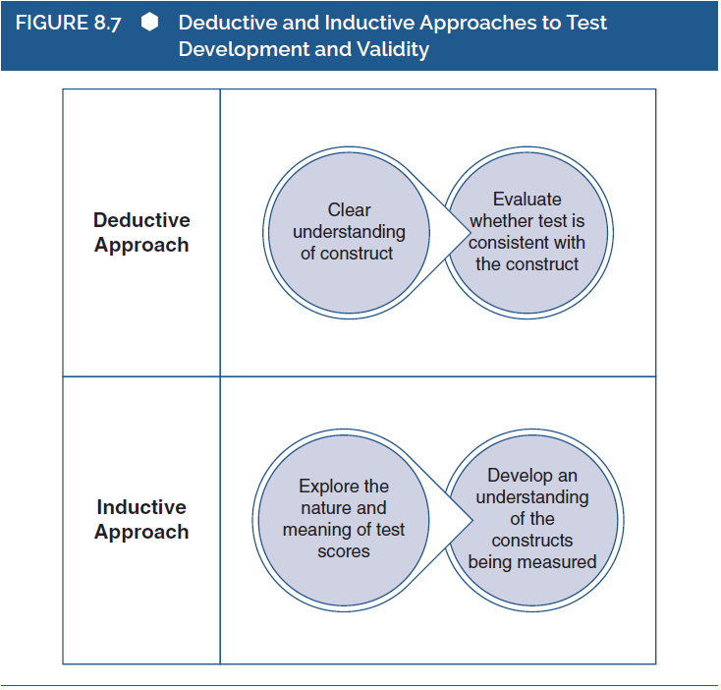
Other Perspectives on Validity
Notes:
Figure 8.7: Deductive and inductive approaches to test development and validity.

Slide 25
Contrasting Reliability and Validity
Reliability: A property of test responses and test scores.
Validity: A property of interpretation of test scores.
Reliability and validity are strongly linked!
Notes:
Reliability:
A property of test responses and test scores.
The degree to which differences in test scores reflect differences among people in their levels of the trait that affects test scores, whatever that trait might be.
Validity:
A property of the test scores interpretation.
Intrinsically tied to the interpretation of test scores and to the nature of the trait supposedly being assessed by the measure.
Reliability and validity are linked both conceptually and statistically:
For many areas of interest in the behavioral sciences, validity requires reliability.
A valid test of intelligence produces score that are reliable.
Even though validity often requires reliability, the reverse is not true.
A measure might have excellent internal consistency and very high test–retest reliability, but we might not interpret it in a valid manner.

